Slide 1
Jeopardy Game Template
Author slides only • Engine assigns values & Daily Doubles automatically

Slide 2
ROUND 1
Create ONE slide per clue • Order within category matters

Slide 3
It Hurts When I Pee
A 72 yo woman had a 6-months h/o almost daily urinary incontinence that frequently occurs without warning. She was dx w/ urge incontinence 6 weeks ago, and started on oxybutynin. Although the frequency of episodes has decreased, incontinence still occurs 2-3 x week, especially when she is away from home and not near a bathroom. There is no dysuria or hematuria. Physical examination is unremarkable. Laboratory results, including UA and urine culture, are normal.
Which of the following is the best treatment for this patient’s persisting urge incontinence?
Notes:
Bladder training
Pubovaginal sling surgery
Transanal electrostimulation
Vaginal estrogen cream

Slide 4
It Hurts When I Pee
A 74 y/o F is evaluated for a 1-week history of intermittent painless gross hematuria. She has a 3-year h/o stage IV CKD due to diabetic nephropathy, a 12-year history of DM2, diabetic retinopathy, and HTN. Meds: lisinopril, furosemide, insulin glargine, and insulin lispro.
PE: temp: 98.6 °F, BP 128/85 mm Hg, HR76, and RR is 15/min. BMI is 28. The lungs are clear. There are no abdominal masses or costovertebral angle tenderness. There is no edema.
Labs: Cr 2.6, GFR 23, UA: 2+ protein; 25-50 erythrocytes/hpf; No leukocytes, no erythrocyte casts
Which of the following is the most appropriate diagnostic test to perform in this patient?
Notes:
CT of the abdomen and pelvis with IV
Gadolinium-enhanced MRI of the abdomen and pelvis
Radiography of the abdomen and pelvis
Ultrasonography of the abdomen and pelvis

Slide 5
It Hurts When I Pee
A 42y/o F c/o 1 episode of blood in her urine associated with abdominal pain. Abdominal discomfort is chronic and nonlocalized, but she has no history of UTIs. She reports no dysuria, urgency, or frequency. She is sexually active, and her only medication is an OCP. FHX is negative.
PE: Temp 98.6°F, BP 150/100, HR 88, RR 15. BMI is 30. CVS and lung exam is normal. There is no CVT. Abd: there is diffuse tenderness to moderate palpation without rebound. There are palpable masses in the right and left abdomen, with increased discomfort with palpation on the R.
Hct 42%, WBC 8500, BUN 25, Cr 2. UA: RBC - too numerous to count, WBC 3-5, HCG: Negative
Which of the following is the most likely diagnosis?
Notes:
Autosomal dominant polycystic kidney disease
Renal cell carcinoma
Renal vein thrombosis
Urinary tract infection

Slide 6
It Hurts When I Pee
A 27 yo c/o dull, throbbing L testicular pain occurring over the past week. He also notes urinary frequency and dysuria, but no penile discharge. He reports no back pain, weight loss, or fever. He takes ibuprofen as needed for pain. He is sexually active with several different partners and uses barrier protection only intermittently. He reports no testicular trauma.
PE: BP 126/64, HR 90, BMI is 22. The penis appears normal without discharge at the meatus. The left testicle is boggy and exquisitely tender to palpation over the superior pole. The testicular pain lessens with elevation of' the testis. CBC is WNL, UA shows 2 leukocytes/hpf.
Which of the following is the most likely diagnosis?
Notes:
A. Epididymitis*
B. Testicular torsion
C. Urinary tract infection
D. Varicocele

Slide 7
It Hurts When I Pee

Slide 8
Throw Me A Bone
A factory worker sustains a forced flexion injury of the distal interphalangeal (DIP) joint, resulting in a small bone fragment at the dorsal surface of the proximal distal phalanx (mallet fracture).
Which one of the following is the most appropriate management strategy?
Notes:
A. Buddy taping and early range of motion
B. Splinting the DIP joint in extension*
C. Splinting the DIP joint in flexion
D. Referral for surgical repair

Slide 9
Throw Me A Bone
A 47 y/o man is evaluated for the right lateral shoulder pain. He has been pitching during batting practice for a baseball team for the past 2 months. He has pain when lifting his R arm overhead and also when lying on his right shoulder while sleeping. On exam, he has no shoulder deformities or swelling. ROM is normal. He has subacromial TTP, with shoulder pain elicited at 60 degrees pf passive abduction. Also, pain with resisted mid-arc abduction but no pain with resisted elbow flexion or forearm supination. He is able to lower his arm smoothly from a fully abducted position; his strength for abduction and external rotation against resistance is normal.
What is the most likely diagnosis?
Notes:
A. Adhesive capsulitis
B. Bicipital tendinitis
C. Glenohumeral arthritis
D. Complete rotator cuff tear
E. Rotator cuff tendinitis *

Slide 10
Throw Me A Bone
67-year-old male presents with a 10-day history of b/l shoulder pain and stiffness accompanied by upper arm tenderness.
PE: soreness about both shoulders and the patient has great difficulty raising his arms above his shoulders. There is no visual disturbance, and no tenderness over the temporal arteries.
C-reactive protein is elevated and the erythrocyte sedimentation rate is 65 mm/hr (N 0–17). Which one of the following would help to confirm the most likely diagnosis?
Notes:
A. The use of published validated diagnostic criteria B. Synovitis of the glenohumeral joint on ultrasonography C. A response to treatment with prednisone * D. A response to NSAIDs E. A lack of systemic symptoms

Slide 11
Throw Me A Bone
A 56 yo was dx w gout 4 months ago based on recurrent episodes of podagra and a serum urate level of 7.2. Colchicine and allopurinol were initiated at that time and have been maintained at their initial doses. PMH of CKD and HTN, for which he takes losartan.
PE: temp 98.8 °F, BP 130/85, HR 75. BMI is 27. There is no swelling of the joints. The remainder of the examination is unremarkable. Urate level is 6.4, Cr is 2.1
Which of the following is the most appropriate ?
Notes:
Discontinue colchicine
Discontinue losartan
Increase allopurinol *
No change in therap

Slide 12
Throw Me A Bone
A 52 y/o w/ 4-month history of slowly progressive unilateral proptosis. Also enlargement of the glands under his jaw on both sides. He feels well and has no PMH, no meds.
PE: V/s WNL. Marked proptosis of the L eye; no inflammation of the sclerae or conjunctivae. B/l enlargement of the lacrimal, parotid, and submandibular glands. There is an enlarged LN at the R angle of the jaw. The remainder of the examination is normal.
LABS: CBC w/ differential, BMP, LFTs, ANA UA all normal.
MRI: a homogeneous enhancing mass behind the L eye and enlargement of the parotid and submandibular glands.
Bx: a lymphoplasmacytic infiltrate with storiform fibrosis and obliterative phlebitis, rare neutrophils, no granulomas; a monoclonal population of cells is not identified.
Which of the following is the most likely diagnosis?
Notes:
odgkin lymphoma
lgG4-related disease*
Sarcoidosis
Sjogren syndrome

Slide 13
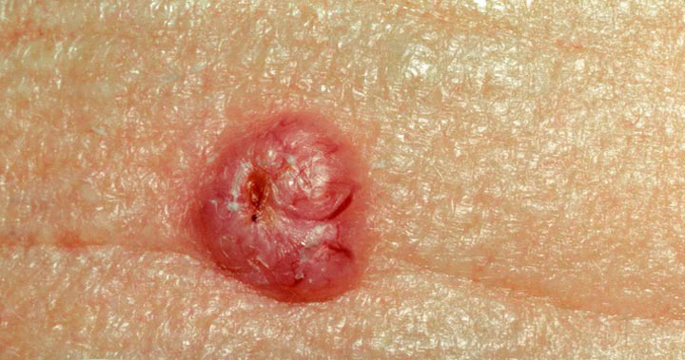
The Skin I live in
A 62 yo man is evaluated for an asymptomatic nodule on his shoulder that has been present for more than 1 year. Which of the following is the most likely diagnosis?
Notes:
Basal Cell Carcinoma *
Pyogenic Granuloma
Seborrheic Keratosis
Squamous Cell Carcinoma

Slide 14
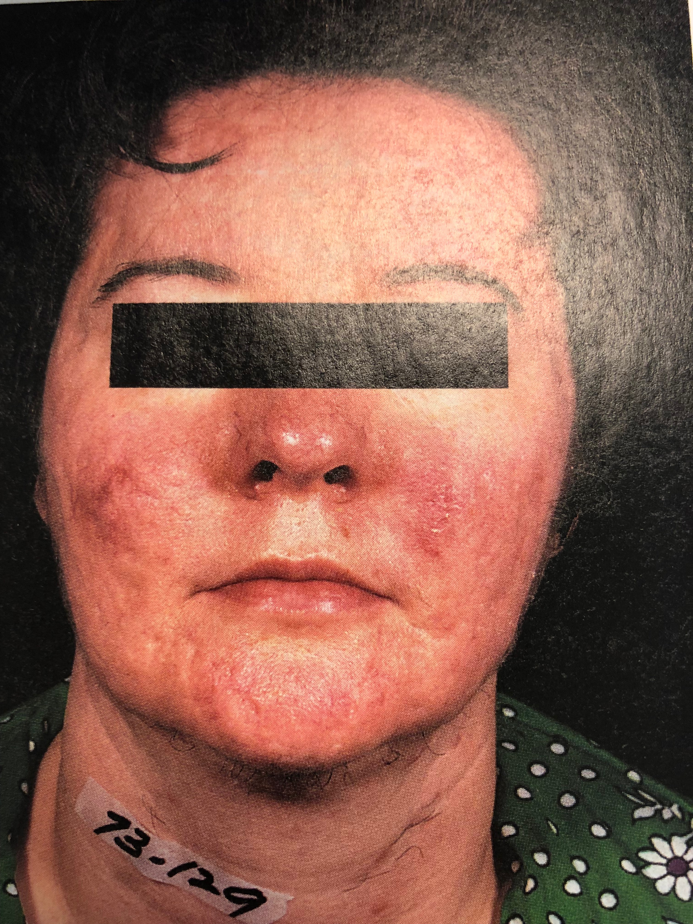
The Skin I live in
A 45 yo woman is evaluated in the office for a facial rash of 6 months’ duration that involves the cheeks and nose. She is unsure of sun exposure worsens the rash. She does not have a rash elsewhere and does not have fatigue, ulcers or joint pain. Rash is limited to the face as shown. The reminder of the examination is unremarkable. CBC, CMP and TSH are normal. Most likely diagnosis?
Notes:
Dermatomyositis
Psoriasis
Rosacea *
Seborrheic Dermatitis
SLE

Slide 15
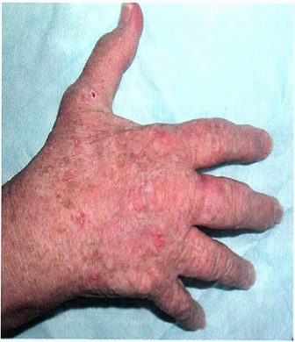
The Skin I live in
A 62-year-old woman is evaluated for multiple areas of scaling and rough skin on her forehead and cheeks. The backs of her hands, and forearms. These areas are painless but persist despite application of moisturizer. No PMH and takes no medications. She has a history of multiple sunburns.
What is the most likely diagnosis?
Notes:
Actinic keratosis *
Seborrheic keratosis
Squamous cell carcinoma
Superficial basal cell CA

Slide 16
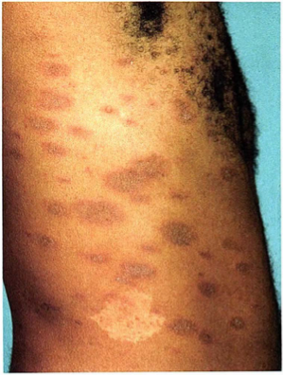
The Skin I live in
20 y/o new scaling rash. 3 weeks ago he developed subjective fever for 2 days with cough and rhinitis that resolved without treatment. One week later, he developed a spot on the R shoulder, and now the rash has spread to his entire trunk and proximal extremities. No lesions in the genital area. He is sexually active. He has no oral, palmar or genital lesions.
Which of the following is the most appropriate management?
Notes:
Hepatitis C virus testing
PCR testing
RPR testing *
No further evaluation

Slide 17
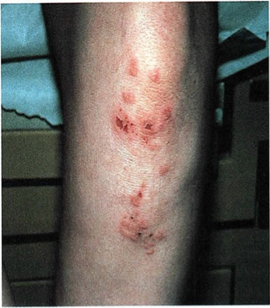
The Skin I live in
32 y/o F w/ 6 mos of new rash on her elbows, knees, and scalp. The rash is intensely pruritic, and she is concerned that it has resulted from insect bites. She has 20 lbs unintentional weight loss. PMH: IBS, takes loperamide PRN.
Which of the following associated conditions is most likely in this patient?
Notes:
Celiac disease *
Hepatitis C
Non-Hodgkin lymphoma
Ulcerative colitis

Slide 18
THE SWEETBREADS
36-year-old obese female presents to your office with a chief complaint of amenorrhea. On examination you note hirsutism and body acne. She is on no medications and a pregnancy test is negative.
Serum testosterone is at the upper limits of normal. TSH is within normal limits.
In addition to weight loss and exercise, which one of the following would be the most appropriate initial management?
Notes:
A. High-dose combined oral contraceptives B. Progestin-only contraceptives C. Metformin (Glucophage) * D. Levothyroxine (Synthroid)

Slide 19
THE SWEETBREADS
While performing a routine physical examination on a 42-year-old female you discover an apparent nodule in the left lobe of the thyroid measuring approximately 1 cm in diameter, which is confirmed on ultrasonography.
The most appropriate next step in the evaluation of this finding is a?
Notes:
A. serum calcitonin level B. serum free T3 level C. serum TSH level D. serum thyroglobulin level E. radionuclide thyroid scan

Slide 20
THE SWEETBREADS
A 37-year-old man is evaluated for a 2-year history of low libido, loss of morning erections, fatigue, and decreasing muscle mass. He takes no medications.
PE: V/W WNL, BMI is 35. The remainder of the examination, including genital examination, is normal. FSH, LH, prolactin, TSH WNL. Testosterone level 148, confirmatory morning testosterone level is 137.
Before initiating therapy for this patient, which of the following should be determined?
Notes:
Bone mineral density
Desire for fertility *
Fasting plasma glucose level
Scrotal ultrasound

Slide 21
THE SWEETBREADS
A 40-year-old man with type 1 diabetes mellitus presents to the office. He seeks advice on his diabetes management as he intensifies his exercise routine in preparation for participation in a 10-K race. He reports prolonged hypoglycemia during intense exercise, despite eating a meal prior to the activity. His insulin regimen is insulin glargine and insulin glulisine.
His most recent hemoglobin A,c level was 7.0%.
Which of the following is the most appropriate management of this patient's hypoglycemia on the days that he exercises?
Notes:
Decrease meal-time insulin glulisine dose prior to exercise, continue insulin glargine dose *
Discontinue insulin glargine, continue insulin glulisine dose
Increase meal-time protein prior to exercise, continue current insulin doses
Switch insulin glulisine to a sliding-scale regimen, continue insulin glargine dose

Slide 22
THE SWEETBREADS
A 33-year-old man is evaluated for infertility. As part of this evaluation, azoospermia is identified on two sequential semen analyses. His medical history is otherwise notable for chronic sinusitis. He takes no medications.
PE: V/S WNL. BMI is 24. There is no evidence of inguinal hernia. A small left-sided varicocele is present that empties when the patient is recumbent. Testicles are of normal size. Absence of the vas deferens is noted bilaterally.
Which of the following is most likely responsible for this patient's infertility?
Notes:
Anabolic steroid abuse
Cystic fibrosis *
Klinefelter syndrome
Varicocele
Y chromosome microdeletions

Slide 23
COUGH IT UP
A 33-y
Notes:
Anabolic steroid abuse
Cystic fibrosis *
Klinefelter syndrome
Varicocele
Y chromosome microdeletions

Slide 24
COUGH IT UP
A 33-y
Notes:
Anabolic steroid abuse
Cystic fibrosis *
Klinefelter syndrome
Varicocele
Y chromosome microdeletions

Slide 25
COUGH IT UP
A 33-y
Notes:
Anabolic steroid abuse
Cystic fibrosis *
Klinefelter syndrome
Varicocele
Y chromosome microdeletions

Slide 26
COUGH IT UP
A 33-y
Notes:
Anabolic steroid abuse
Cystic fibrosis *
Klinefelter syndrome
Varicocele
Y chromosome microdeletions

Slide 27
COUGH IT UP
A 33-y
Notes:
Anabolic steroid abuse
Cystic fibrosis *
Klinefelter syndrome
Varicocele
Y chromosome microdeletions

Slide 28
ROUND 2
Same structure as Round 1 • Values will be doubled by the engine

Slide 29
CATEGORY NAME
ROUND 2 CLUE
• Replace this text with the QUESTION.
• Insert images directly onto the slide if needed.
• Insert audio via Insert → Audio (optional).
Put the ANSWER in the Speaker Notes.
Notes:
ANSWER GOES HERE (e.g., What is … ?)

Slide 30
CATEGORY NAME
ROUND 2 CLUE
• Replace this text with the QUESTION.
• Insert images directly onto the slide if needed.
• Insert audio via Insert → Audio (optional).
Put the ANSWER in the Speaker Notes.
Notes:
ANSWER GOES HERE (e.g., What is … ?)

Slide 31
CATEGORY NAME
ROUND 2 CLUE
• Replace this text with the QUESTION.
• Insert images directly onto the slide if needed.
• Insert audio via Insert → Audio (optional).
Put the ANSWER in the Speaker Notes.
Notes:
ANSWER GOES HERE (e.g., What is … ?)

Slide 32
CATEGORY NAME
ROUND 2 CLUE
• Replace this text with the QUESTION.
• Insert images directly onto the slide if needed.
• Insert audio via Insert → Audio (optional).
Put the ANSWER in the Speaker Notes.
Notes:
ANSWER GOES HERE (e.g., What is … ?)

Slide 33
CATEGORY NAME
ROUND 2 CLUE
• Replace this text with the QUESTION.
• Insert images directly onto the slide if needed.
• Insert audio via Insert → Audio (optional).
Put the ANSWER in the Speaker Notes.
Notes:
ANSWER GOES HERE (e.g., What is … ?)

Slide 34
FINAL JEOPARDY
FINAL JEOPARDY QUESTION
• Only ONE slide
• Insert image/audio if desired
• Teams will enter wagers in the game
Put the ANSWER in the Speaker Notes.
Notes:
FINAL JEOPARDY ANSWER (e.g., What is … ?)

